Slide 1
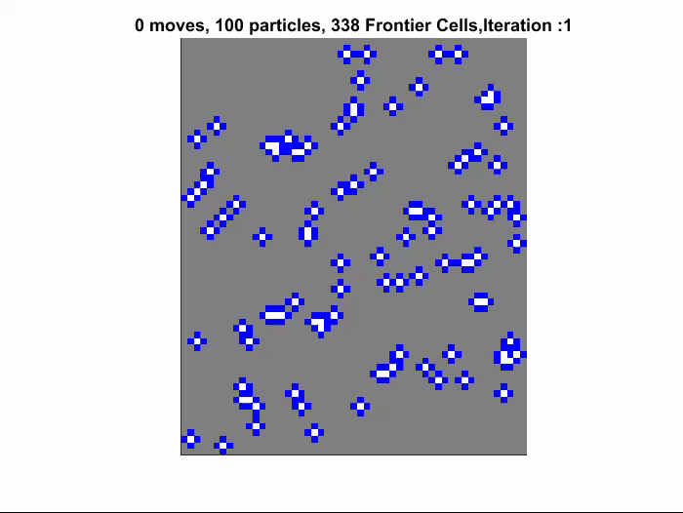
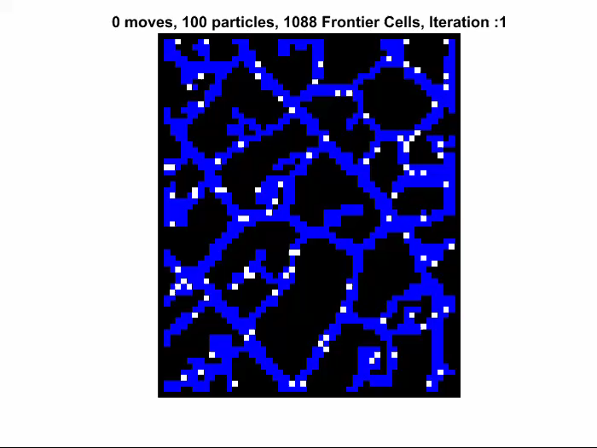
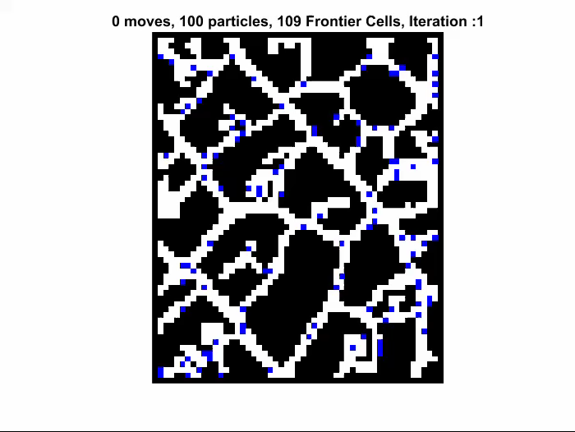
Mapping, Foraging, and Coverage with a Particle Swarm Controlled by Uniform Inputs
Arun Mahadev, Dominik Krupke, Sándor P. Fekete, and Aaron T. Becker
Notes:
In our work we present benchmarking algorithms for a novel approach towards mapping of tissue and vasculature based on moving and measuring magnetic particles that are commanded by a global uniform input such as an MRI. The red particles which represent the micro particles need to visit frontier cells in blue in order to cover them or explore them.

Slide 2
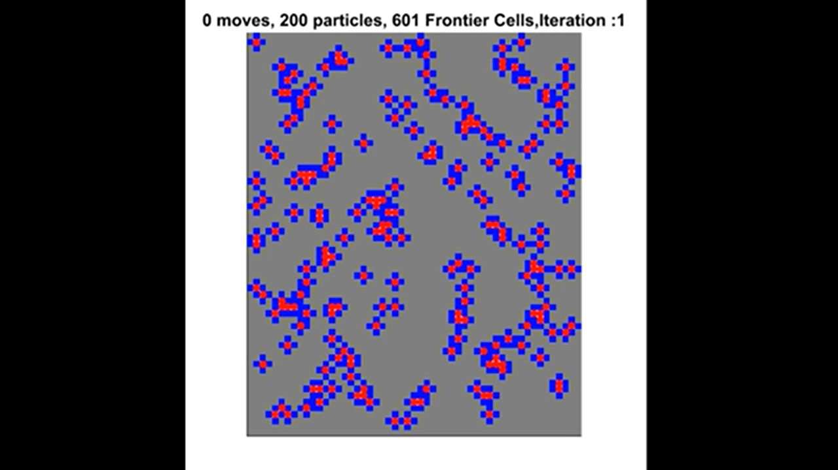

Slide 3
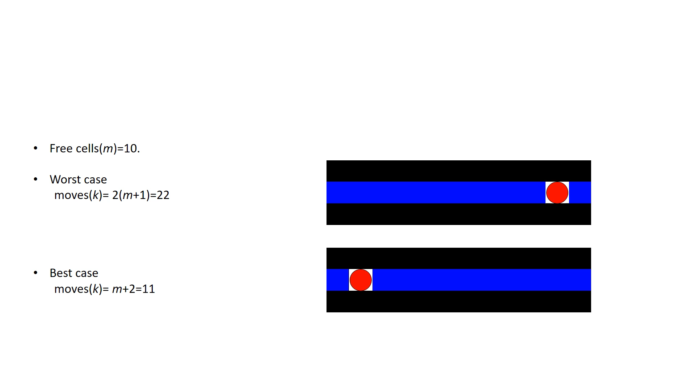
Linear 1D mapping 1 particle
Notes:
We study the three related problems in 1D and 2D grid environments. For mapping a linear space we show that the number of moves can be bounded for single particle and n particle case. We also examine mapping when scanning and moving have associated costs since an MRI can only do one at a time.

Slide 4
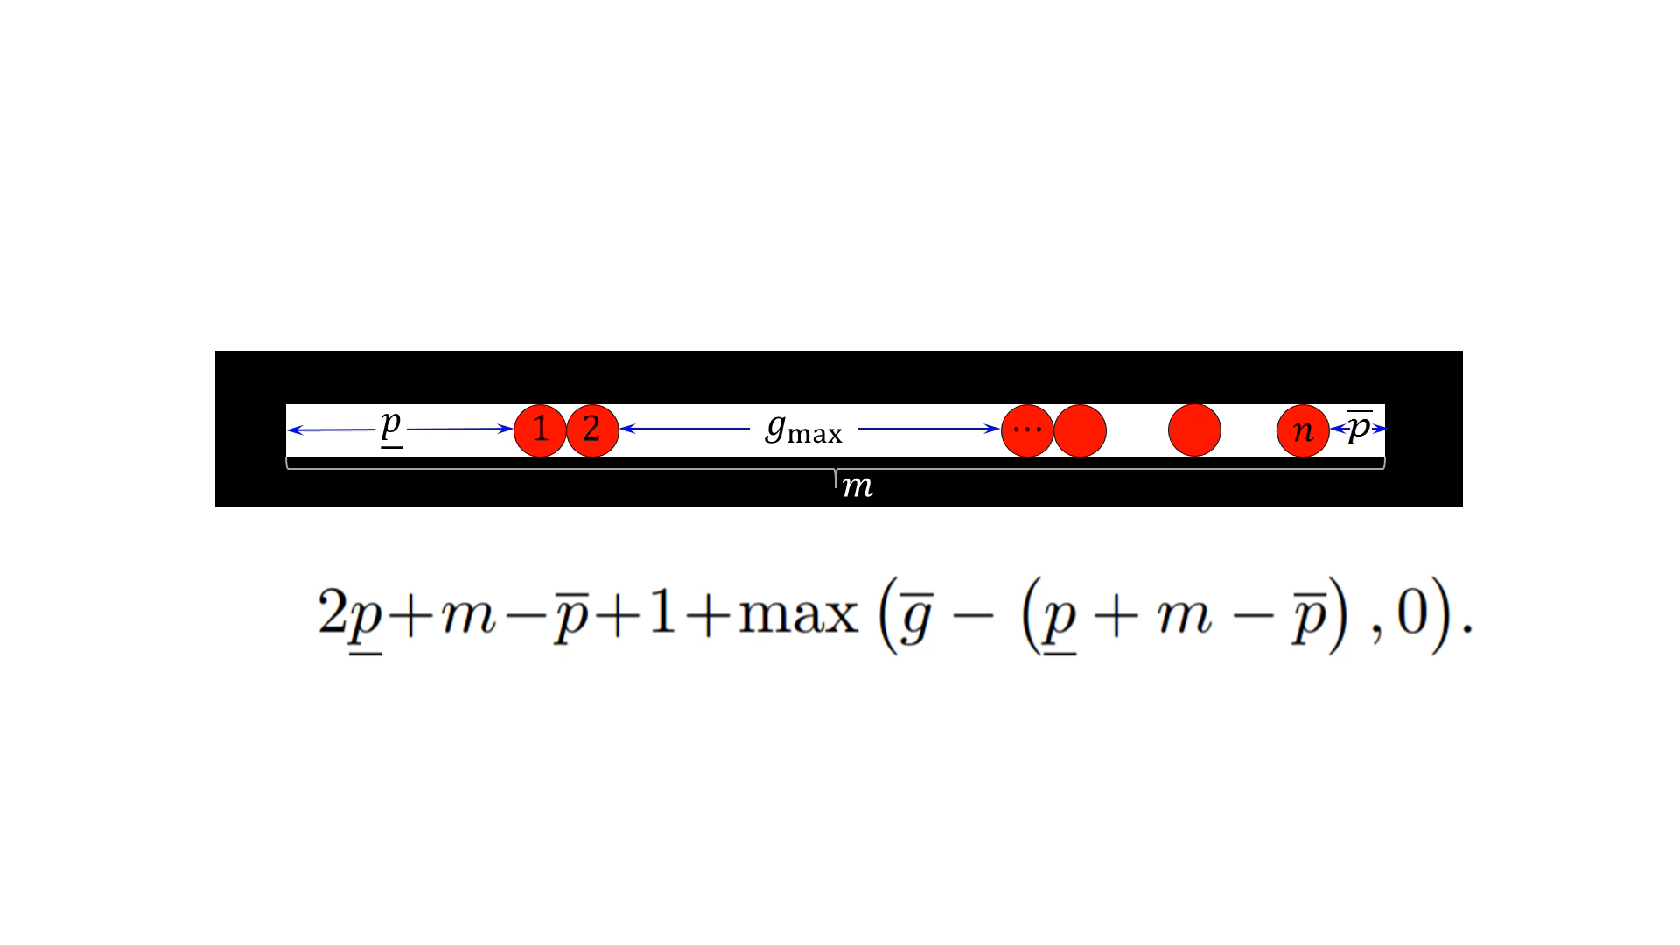
Linear 1D mapping n particles
Notes:
We study the three related problems in 1D and 2D grid environments. For mapping a linear space we show that the number of moves can be bounded for single particle and n particle case. We also examine mapping when scanning and moving have associated costs since an MRI can only do one at a time.

Slide 5
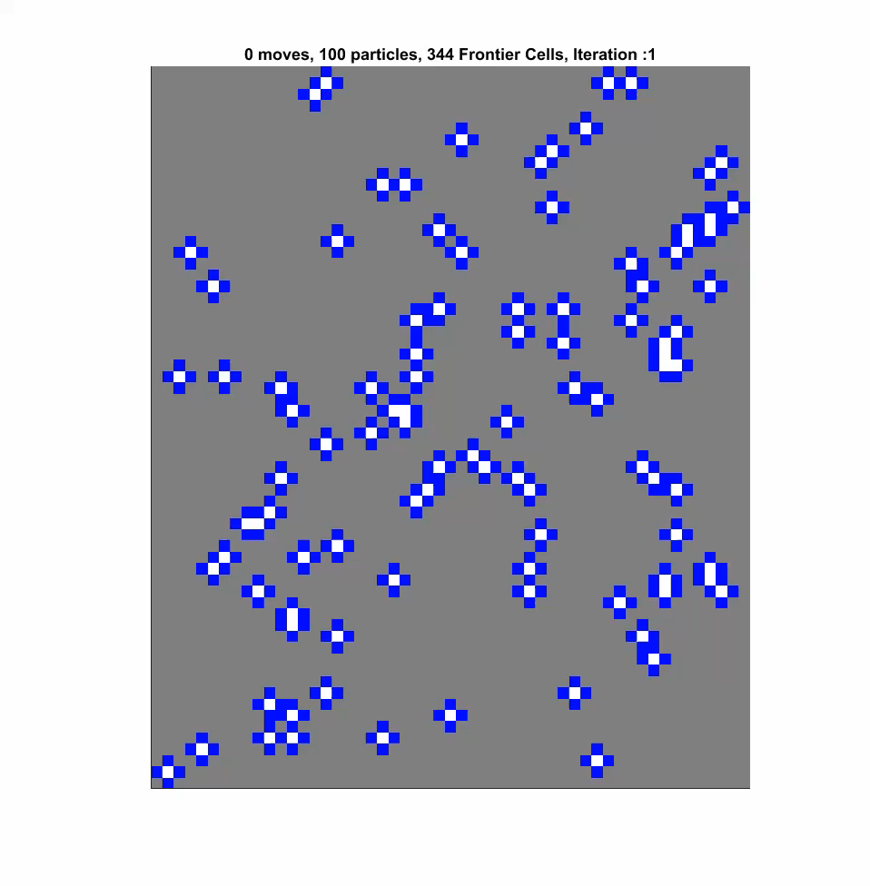
Random Moves

Slide 6
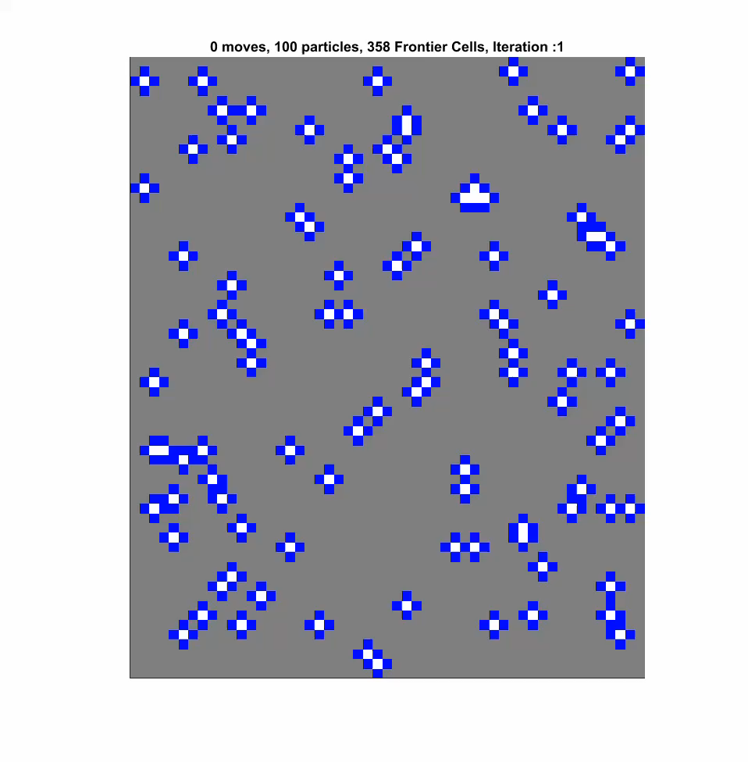
Elect Particle
Notes:
The performance of the algorithms depends on: map complexity such as perimeter and number of turns. The distribution of particles. And the number of particles.

Slide 7
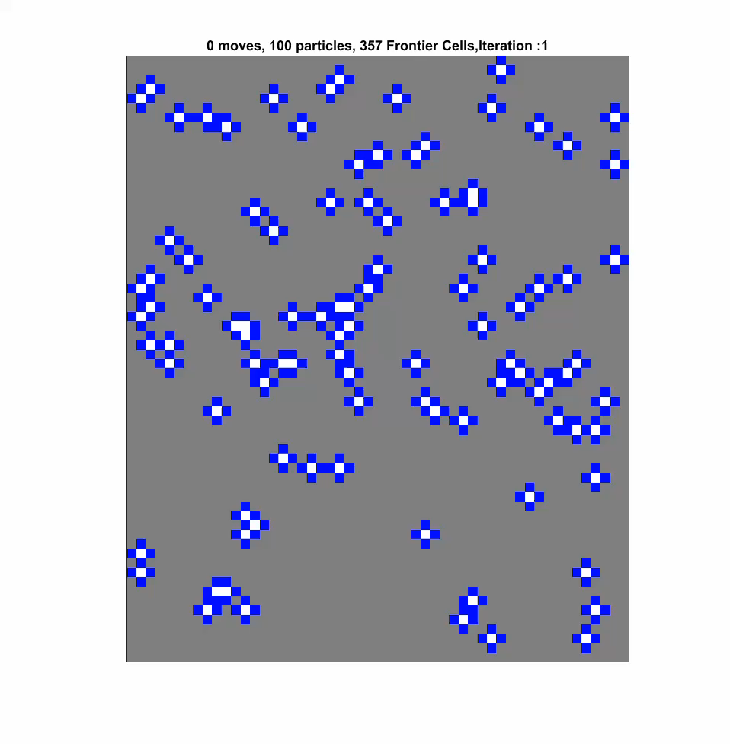
Closest Frontier
Notes:
For 2D, we provide 3 algorithms of increasing complexity: random moves, a probabilistically complete algorithm where each move is random, elect particle, where path planning is made based on proximity of an elect particle in green, to it’s closest frontier and thirdly closest frontier algorithm which exploits the proximity of a particle to a frontier cell. Planning is based on the closest frontier particle pair and it gives the shortest path of all. We also study the worst case scenario of 2D mapping to give a holistic picture of the challenges faced in global control.

Slide 8
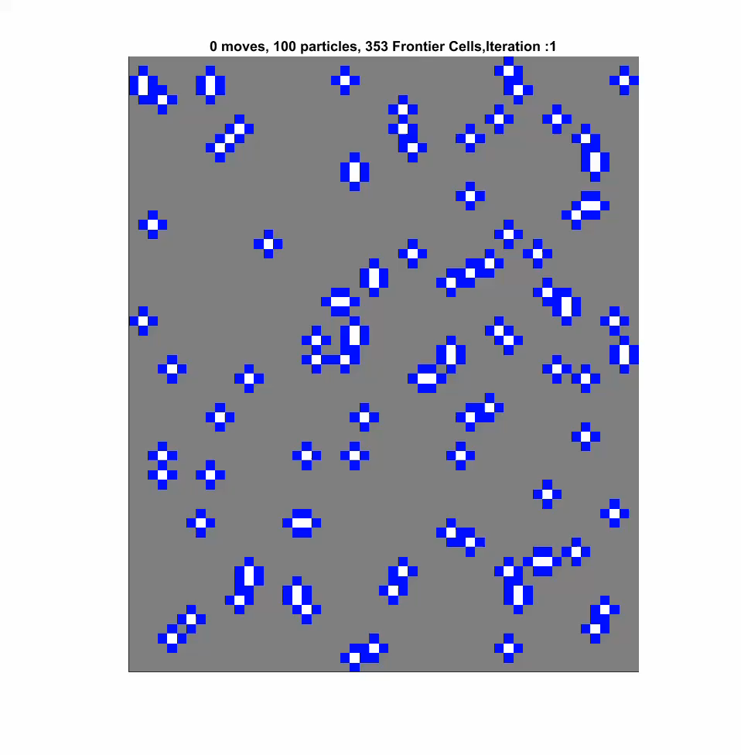
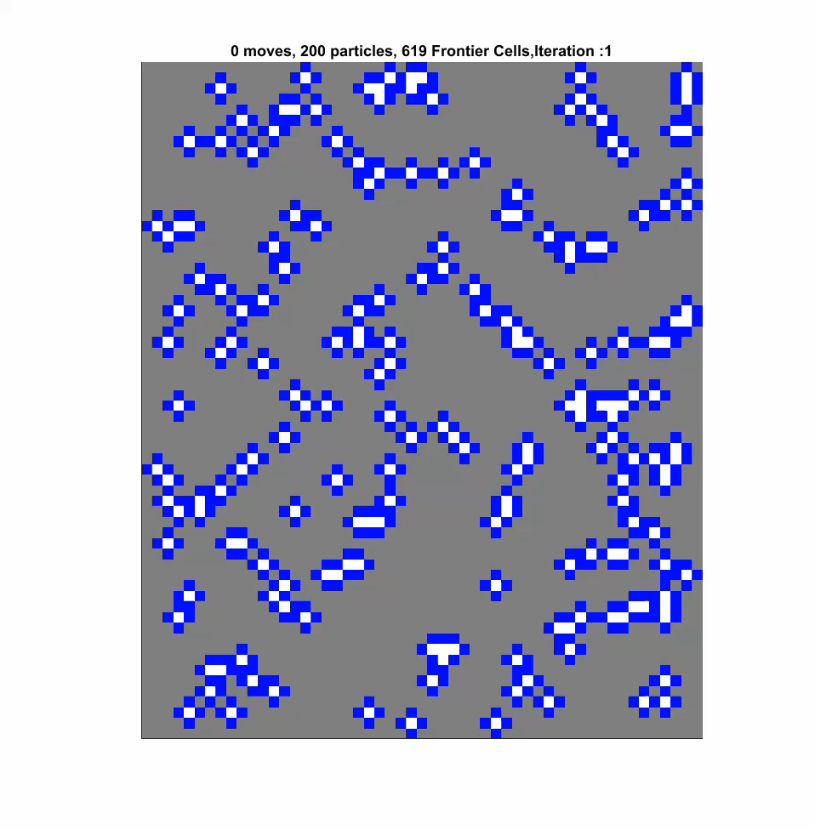
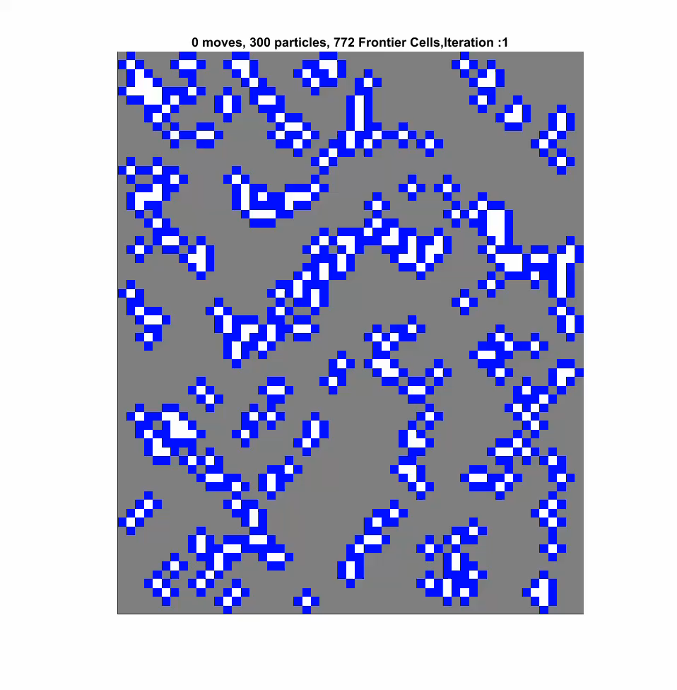
Number of particles

Slide 9
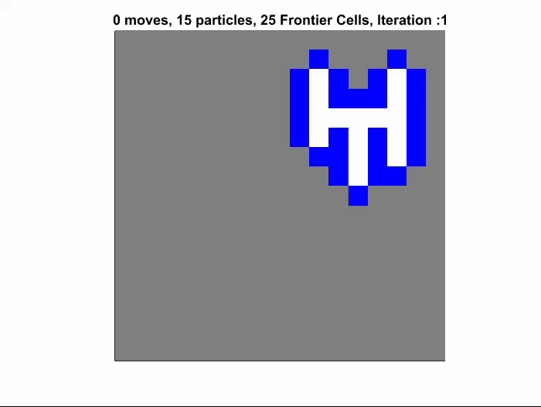
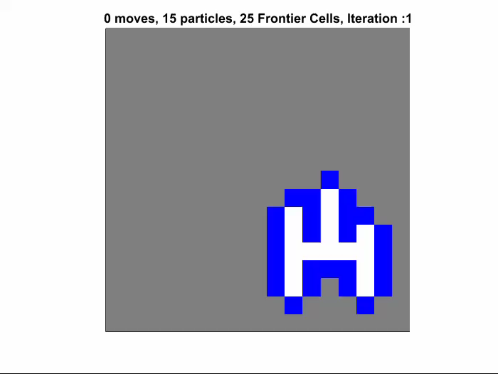
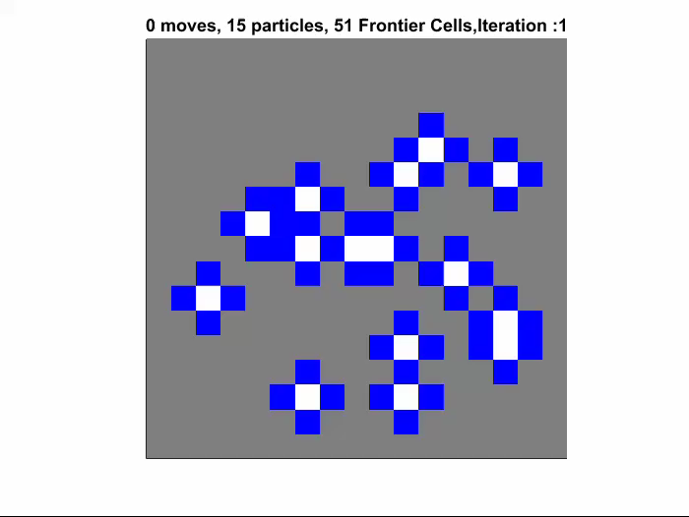
Region Fill Flood Fill Uniform Fill
Notes:
In the simulation analysis, we compare the performance of algorithms, different distributions and different maps. All simulations were performed on map size of 5000 free cells and repeated 100 times to obtain mean and standard deviations.
The results obtained in this work are of significant importance in understanding the constraints and challenges in particle manipulation and set a benchmark for future work.

Slide 10
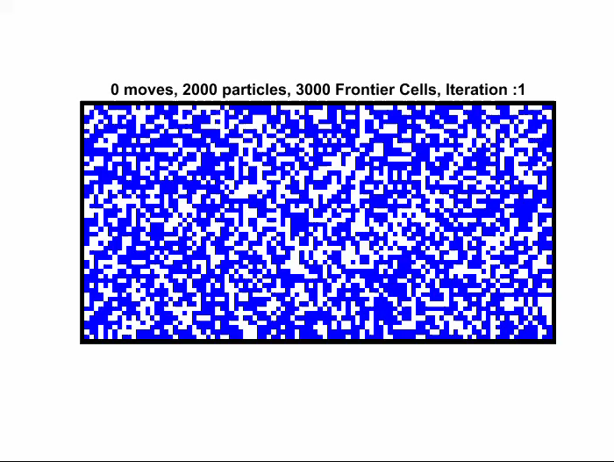
Empty Rectangle

Slide 11
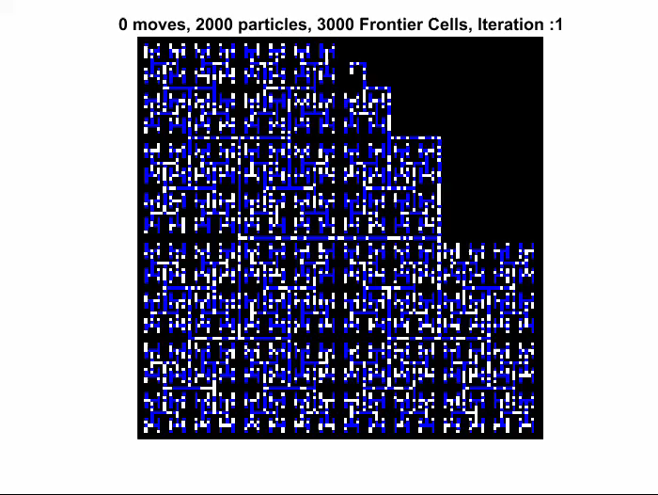
H-tree

Slide 12
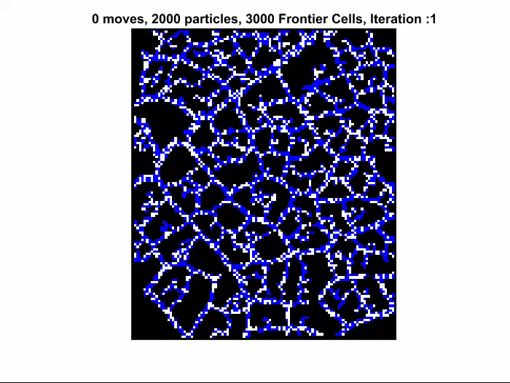
Complex Map

